Slide 1


Slide 2

OC SPRAY
Instructor:
Date:

Slide 3
Topic: OC Spray
Objectives:
  Examine the history of OC Spray
  Examine how OC Spray works
  Discuss the Use Of Force context for this module
  Discuss the effects of OC Spray
  Discuss decontamination procedures
  Discuss the pros/cons of OC Spray
Method of Instruction: Lecture developmental, practical demonstration
Training Aids: Presentation, demonstration, written exam
Pen and Paper are Required

Slide 4
Introduction
Officers are often faced with violent or resistive subjects in their daily patrols. In some cases soft or hard empty hand control techniques are not effective, but the level of resistance does not warrant the use of lethal force.

Slide 5
Introduction
OC Spray is a less than lethal force option, allowing the Officer to gain control over a subject while minimizing the level of injury the subject will sustain.

Slide 6
The History Of OC Spray
Approximately 2 000 years ago the Chinese first used ground pepper as a weapon, throwing it in the eyes of enemies during hand to hand combat
Modern OC Spray was developed and designed in the 1980’s for the US Postal Service as a dog/animal repellent
In 1982 the first Police agencies in the USA began to test and deploy OC Spray to Officers

Slide 7
How Does OC Work?
OC stands for oleoresin capsicum
  Capsicum is the Latin word for pepper and is the genus-level designation for all peppers used in seasonings for hotness. Hence, oleoresin (oleo = oil and resin= extract obtained from a plant) capsicum (pepper) means quite literally "pepper extract in oil".

Slide 8
How Does OC Work?
Derived from the extract of the capsicum pepper plant, OC spray causes inflammation and edema over areas of contact (primarily the face, eyes, nose and mouth), resulting in pain and discomfort such that many victims lose their capacity to resist.

Slide 9
How Does OC Work?
All pepper sprays have in common the following 3 components:
1) oleoresin capsicum (OC for short; the oily residue extracted from hot red peppers that naturally contains the active ingredient - capsaicin - that elicits an intense burning sensation),
2) a carrier, or base, fluid into which the oleoresin capsicum is mixed to thin and dilute it, and
3) a propellant that supplies the energy to expel the carrier and active ingredients from the can.
Most Police OC Sprays are 10% Oleoresin Capsicum in a non-flammable propellant

Slide 10
How Does OC Work?
OC is measured in Scoville units
  The Scoville scale is a measure of the hotness of a chile and the number of Scoville heat units (SHU) indicates the ratio of capsaicin present
  As originally devised, a solution of the pepper extract is diluted in sugar water until the 'heat' is no longer detectable to a panel of (usually five) tasters; the degree of dilution gives its measure on the Scoville scale
Habaneras have a SHU of 300 000 or more. Modern Police OC Spray has a SHU of 5 300 000

Slide 11
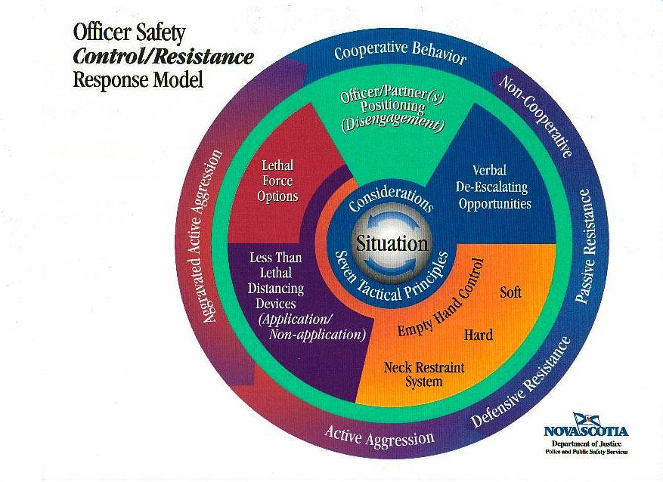

Slide 12
Force Level Option
Classified as Less Than Lethal Distancing Device
Used in relation to Active Aggression

Slide 13
Force Level Option
To use these options there must be no lower level of force available to you
The amount of force you use can not be disproportionate to the level of resistance

Slide 14
Force Level Option
When can OC be used?
  Size difference between offender and Officer
  Age difference
  Ability difference
  Ability of offender to escalate the danger level to an officer
  OC is a legitimate option only when alternatives present a clear risk of injury to the subject or peace officer
  When empty hand control is inappropriate or unsuccessful and lethal force is not justified

Slide 15
Effects of OC Spray
Physiological effects:
  Does not always work on everyone / not always immediate
  Involuntary closing of eyes
  Gagging / shortness of breath
  Sensation of intense burning

Slide 16
Effects of OC Spray
Psychological Effects:
  Disorientation and panic due to gagging / shortness of breath and lack of clear sight

Slide 17
Pro’s of OC Spray
The physical effects of being sprayed with oleoresin capsicum (OC) may significantly reduce an individual's aggressive behavior. The effects range from tearing, involuntary closing of the eyes, and burning and redness of exposed skin, to coughing, gagging, and shortness of breath, to loss of motor skills or muscle coordination.
OC sprays seem to leave few if any residual effects, allowing suspects to be transported without affecting transporting officers. Decontamination protocol normally requires only fresh air and soap and water.

Slide 18
Con’s of OC Spray
The suspect must be within the effective range of the product for the OC spray to work. If the suspect is too close or too far from the officer, the spray may not be effective. Likewise, if the aerosol is sprayed in bursts that are either too short or too long, its effectiveness may be hampered. Because manufacturers use different mixtures of chemicals and spray patterns, it is always best to follow the manufacturers instructions to ensure optimum performance.
Eyeglasses, sunglasses, and other protective eyewear and clothing may greatly reduce the effectiveness of OC sprays. The spray's effectiveness may also be reduced by a suspect who throws up his hands in a defensive measure to block the spray.
If the subject is under the influence of a controlled substance or is goal oriented, the spray can have little to no effect.
There is a danger of cross contamination

Slide 19
Con’s of OC Spray
http://blutube.policeone.com/police-tasers-videos/932426271001-taser-rcmp-testing/

Slide 20
Decontamination Procedures
Subdue the subject. Handcuff and search for weapons. Reassure the subject that the effects are short-term and you are attempting too help him / her.
If the subject is wearing lenses, ask them to remove them as soon as possible or practical. DO NOT remove them yourself. Remove contaminated clothing, if practical.
Flush contaminated areas with large amounts of cold water and expose flesh to fresh air.
Seek medical attention if irritation or serious reaction to OC persists. Most effects should dissipate within 45 minutes.

Slide 21
Decontamination Procedures
If an officer suffers cross-contamination (accidental exposure) he /she can reduce these effects by strobe blinking, forced breathing, and using commercial decontamination spray or wipes

